Slide 1
机器人与无人机协同组网

Slide 2
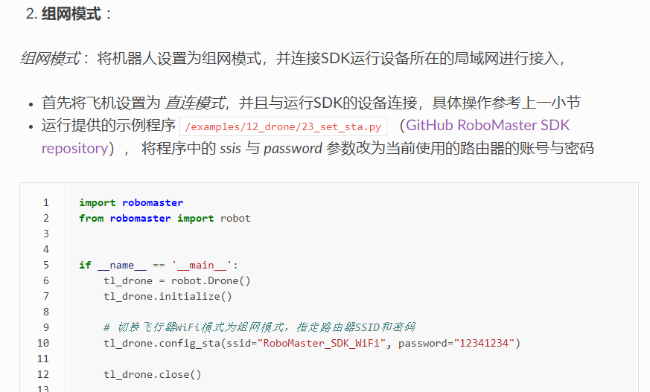
一、无人机组网（23_set_sta.py）
https://robomaster-dev.readthedocs.io/zh_CN/latest/python_sdk/connection.html

Slide 3
二、机器人与无人机协同组网：（DroneAndRobot.py）
from robomaster import robot if __name__ == '__main__': tl_drone = robot.Drone() tl_drone.initialize(conn_type="sta") ep_robot = robot.Robot() ep_robot.initialize(conn_type="sta") # 获取飞机SN信息 SN = tl_drone.get_sn() print("drone sn: {0}".format(SN)) SN = ep_robot.get_sn() print("Robot SN:", SN) tl_drone.close() ep_robot.close()

Slide 4
三、机器人识别标签卡 （01_marker -num.py）
for i in range(0, 500): img = ep_camera.read_cv2_image(strategy="newest", timeout=0.5) for j in range(0, len(markers)): cv2.rectangle(img, markers[j].pt1, markers[j].pt2, (255, 255, 255)) cv2.putText(img, markers[j].text, markers[j].center, cv2.FONT_HERSHEY_SIMPLEX, 1.5, (255, 255, 255), 3) marker_last_num =markers[j].text cv2.imshow("Markers", img) cv2.waitKey(1) cv2.destroyAllWindows()

